Slide 1
Devices
Ying shen
Sse, tongji university
Jan. 2018

Slide 2
Outline
Introduction
Keyboards and keypads
Pointing devices
Displays

Slide 3
Outline
Introduction
Keyboards and keypads
Pointing devices
Displays

Slide 4
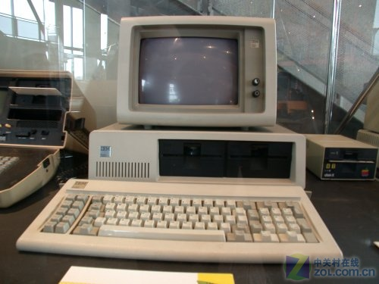
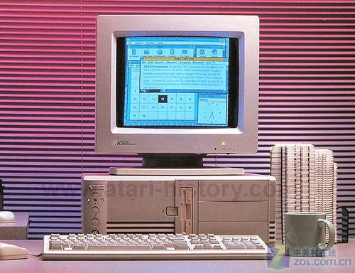
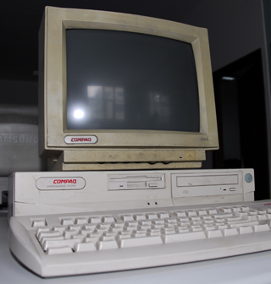
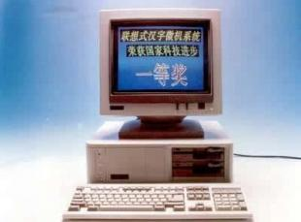
Introduction
Input and output devices represent the physical medium through which users operate computers
Only two decades ago, the standard computer platform was the desktop or laptop personal computer equipped with a screen, a mouse, and a keyboard

Slide 5
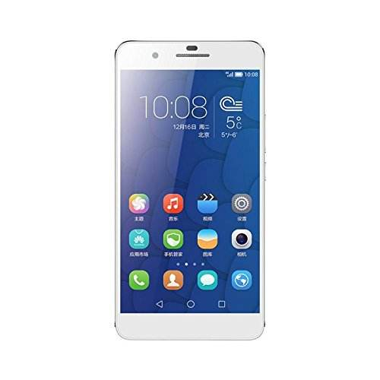
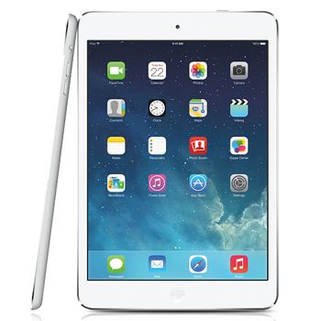
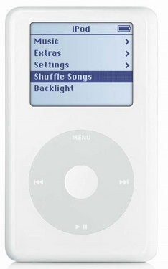
Introduction
Mobile devices have revolutionized the face of computing
Many people do not realize that their ever-present smartphones, tablets, or portable MP3 players are, indeed, powerful computers

Slide 6
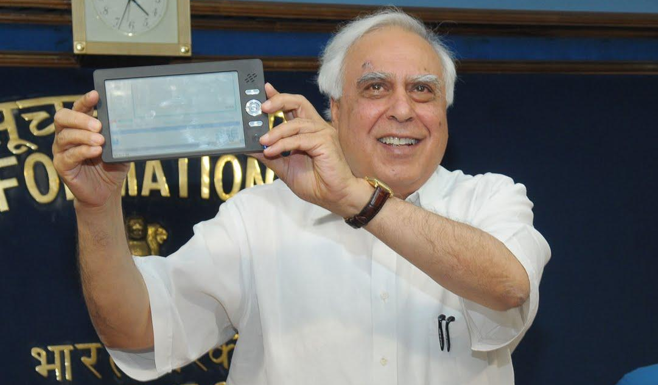
Introduction
Device example
Indian IT minister Kapil Sibal announcing the Aakash, a $35 tablet for the Indian market
Notes:
Aakash采用安卓2.2系统，7英寸的触摸屏，2GB外部记忆装置，2个USB接口，内设Wi-Fi机能，电池续航能力为3小时，价格为1台2500印度卢比（约合人民币298元左右）。Aakash将是目前世界中最便宜的平板电脑。
新一代的Aakash 2，处理器升级到了ARM A8级别，处理频率达到了1GHz。同时Aakash 2也将显示屏提升到了分辨率为800×480的7英寸电容屏。同时运行内存也升级到了512M，存储空间也提升到了4GB，并且可以通过microSD卡槽扩展到32GB。连接方面，Aakash 2支持接入WiFi，并且配有一个3.5mm耳机插口。Aakash 2的系统也与时俱进的升级到了Android 4.0冰欺凌三明治，配有VGA分辨率前置摄像头支持视频通话，3000毫安的电池容量可以坚持最长3个小时。
纽约时报旗下India Ink爆出Aakash 2是在中国设计与生产，印度人只是套了牌而已。针对这一问题，印度媒体查看了Datawind公司在今年10月26至11月7日间分别从至少4家位于深圳和香港的中国企业购买了11000台“A 13”平板电脑的发票，发票显示Datawind采购价格是每台42-42.86美元之间，而这恰好是他们卖给印度政府的价钱，这些电脑随后以免税的方式被运输到印度

Slide 7
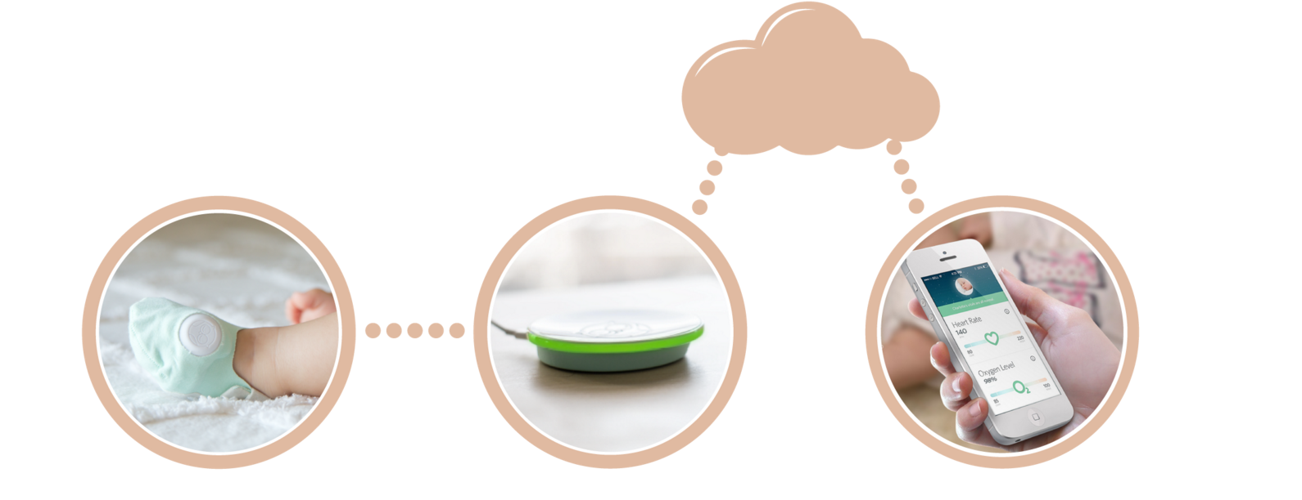
Introduction
Another device example
The Owlet wearable baby monitor that continuously tracks a baby’s heart rate and oxygen saturation using a so-called “smart sock” (left) and wirelessly sends the information to a base station (center)
Notes:
The Owlet wearable baby monitor that continuously tracks a baby’s heart rate and oxygen saturation using a so-called “smart sock” (left) and wirelessly sends the information to a base station (center)
The base station is in contact with the internet, and uploads data that parents can access using their smartphone (right)

Slide 8
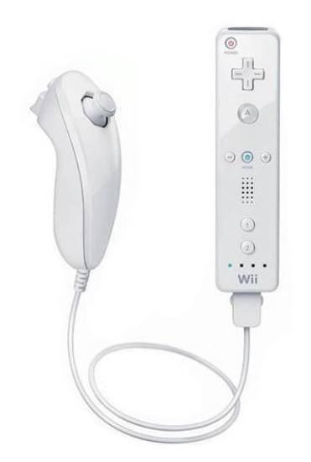
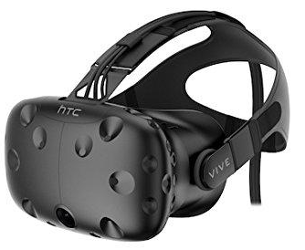
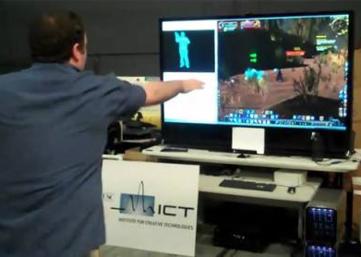
Introduction
The explosion of new and exciting computing technology has increased the importance of interaction design so as to accommodate such a wide diversity of input and output modalities

Slide 9
Outline
Introduction
Keyboards and keypads
Pointing devices
Displays

Slide 10
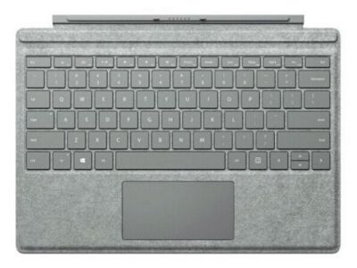
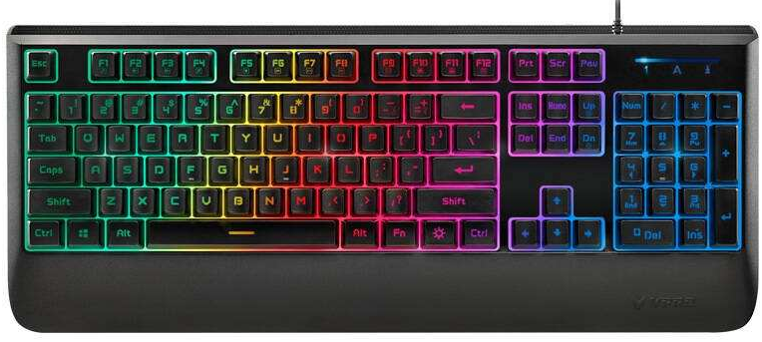
Keyboards and keypads
The keyboard is the primary mode of text entry
Despite having received much criticism over the years, the keyboard is very successful and still represents the most efficient text-entry mechanism

Slide 11
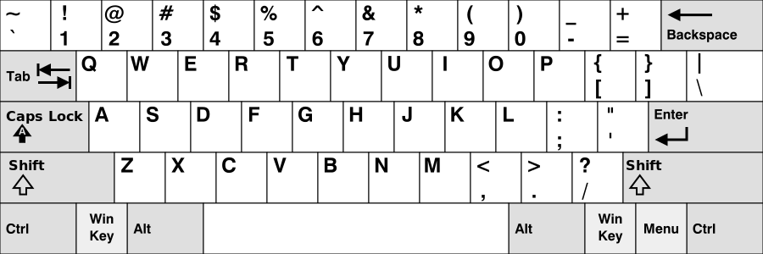
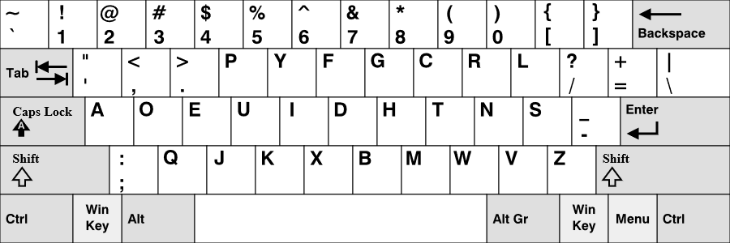
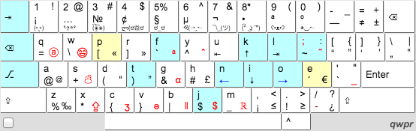
Keyboard layouts
QWERTY Keyboard
Dvorak Keyboard
QWPR Keyboard
Notes:
https://en.wikipedia.org/wiki/Keyboard_layout

Slide 12
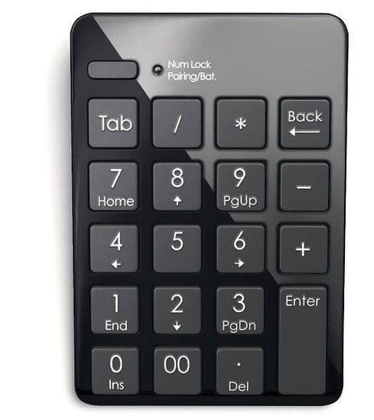
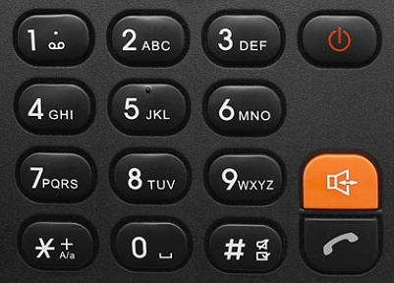
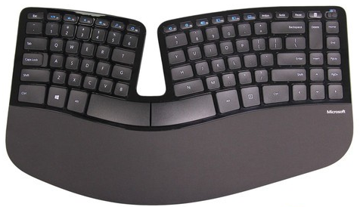
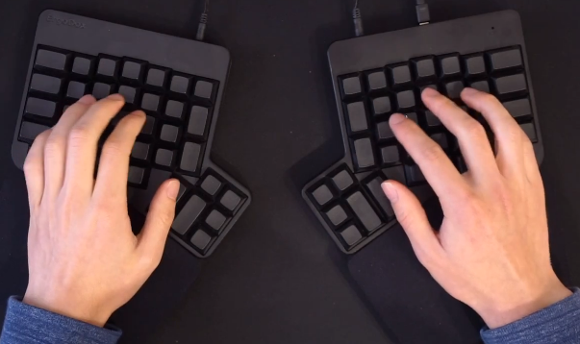
Keyboard layouts
Number pads
Ergonomic keyboard
Notes:
http://ju.outofmemory.cn/entry/118873
微软Sculpt ErgoDox
https://www.bilibili.com/video/av17907371?from=search&seid=3539160380546178263

Slide 13
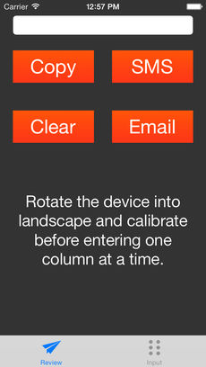
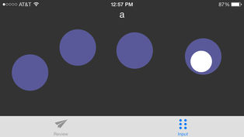
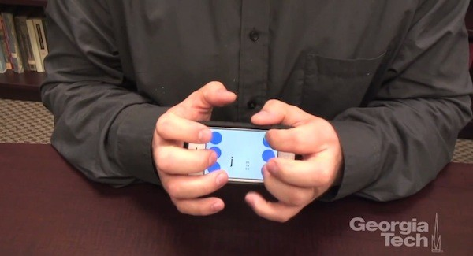
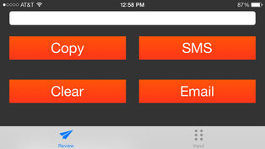
Accessible “keyboard”
Approaches to facilitate users inputting texts include:
Adaptive keyboards
On-screen keyboards using head pointers or oversized trackballs
PerkInput and BreaillTouch provide nonvisual input methods
Notes:
Perkinput is a new way to enter text on your iPhone or iPad without using a keyboard. Perkinput is based on the Braille keyboard, where you simultaneously press down with the fingers that correspond to the dots for the letter you want to enter. Unlike the Braille keyboard, however, you enter text with just one hand. You tap the screen twice to enter one letter instead of pressing down with two hands at once. After you enter something in the Perkinput app, you can send that text in an email, a text message, or simply copy the text and paste it in any other application.
研究人员在一款为盲人设计的打字软件的基础上进行了改进，用户在打字的时候需要将触摸屏翻转向下，双手的食指、中指及无名指自动对应屏幕上的六个按键，而六个按键可以带来63种组合，足够应对英文的打字输入了，而手机侧面的两个按键可以起到回车键和删除键的作用。
据称，在熟练操作这款软件后，可以达到每分钟输入32个词的速度，输入准确率在92%以上。这款软件不仅适用于视力受损的人群，同样适用于普通人，比如开会想偷懒的时候，看着手机发短信肯定不合适，有了它，在桌子下面盲打短信岂不是很爽？目前这款软件支持iPad和iPhone，研究人员正在开发支持其他平台的软件版本。

Slide 14
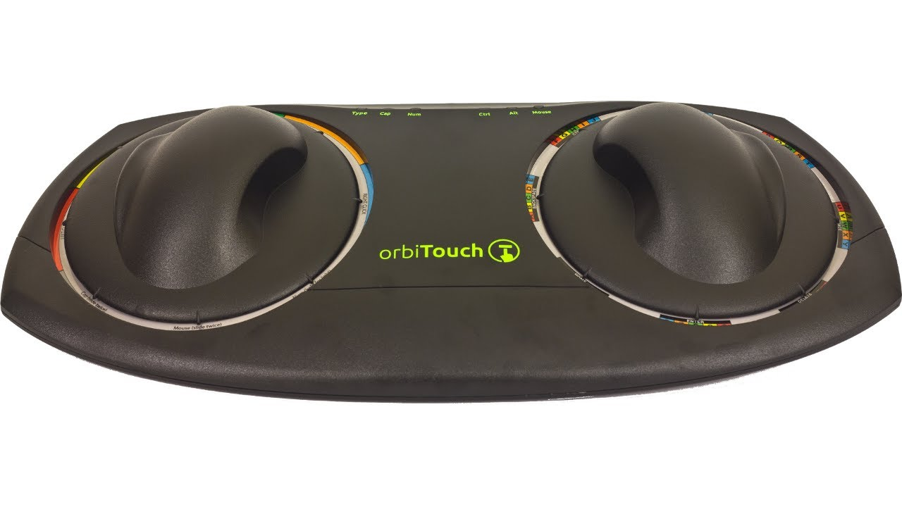
Accessible “keyboard”
orbiTouch Keyless Keyboard with integrated mouse functionality
The orbiTouch requires no finger or wrist motion to operate, yet supports high-performance typing and pointing
Notes:
这款名为OrbiTouch的新型键盘就实现了键盘的无键化。它的外形非常古怪，主体由两个符合人体工学设计的掌托构成，每个掌托可以分别像八个方向推动，左边的掌托有红黄绿橙蓝五个方向，右边的掌托则在八个方向上排列有26个字母、10个阿拉伯数字以及一些常用的符号。这些符号每五个一组排列在四周，而且每组的符号都用红黄绿橙蓝来标注，这样，你的左手向某个颜色推动时候，右手同时向带有目标字母的方向推动就可以将字符输入进电脑了。这样一来由于无须单个手指的频繁活动，同时又能对手掌给于很好的支撑，就可以有效避免因为长时间敲击键盘带来的肢体重复性劳损。
另外，该产品同时还内置有鼠标功能，让你不必移动双手就可以实现键盘和鼠标之间的切换
https://www.orbitouch.com/

Slide 15
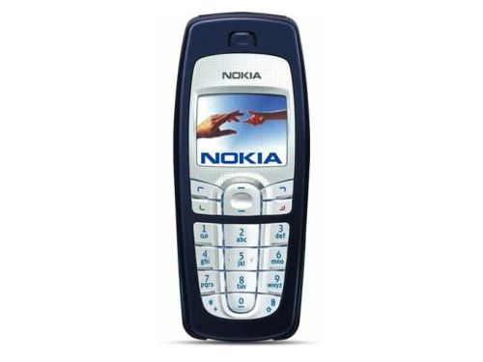
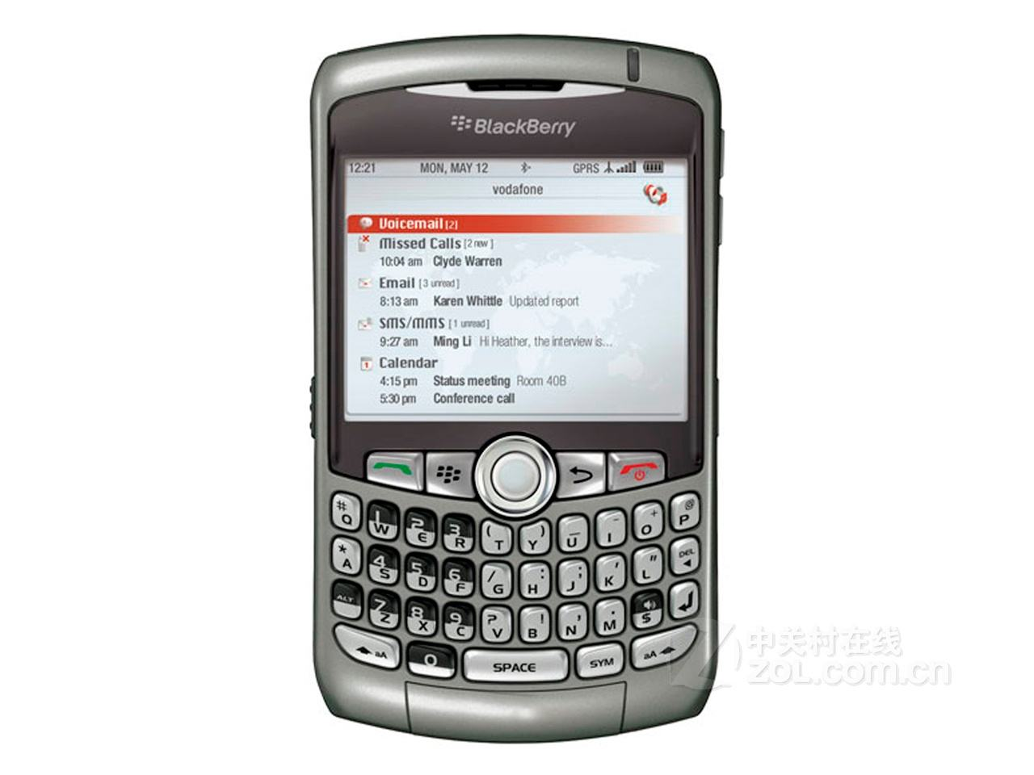
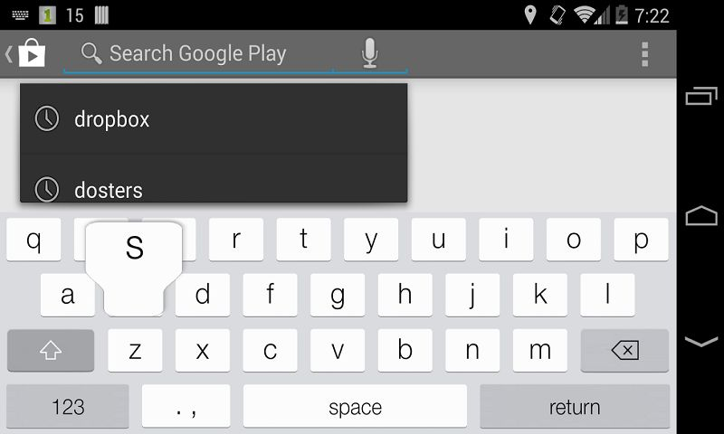
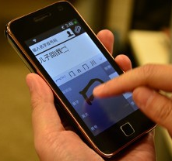
Mobile text entry
Most older mobile devices provide only a numeric keypad
Smartphones tends to eschew physical keyboards in favor of soft keyboards
However, soft keyboards lack the tangible and tactile feedback of a physical keyboard
To improve text entry on touchscreens, possible words are predicted for users

Slide 16
Outline
Introduction
Keyboards and keypads
Pointing devices
Displays

Slide 17
Pointing devices
It’s convenient for the user to point at and select items
This direct-manipulation approach is attractive because the users an avoid having to learn commands, reduce the chance of typographic errors, and keep their attention on the display
Pointing devices are also important for small devices and large wall displays

Slide 18
Pointing tasks and control modes
Pointing devices are useful for seven types of interaction tasks:
Select – Choosing from a set of items.
Position – Choosing a point in a one-, two-, three-, or higher-dimensional space
Orient – Choose a direction in a two-, three-, or higher-dimensional space.
Path – Define a series of positioning and orientation operations
Quantify – Specify a numeric value
Gesture – Perform an action by executing a predefined motion
Text – Enter, move, and edit text in two-dimensional space

Slide 19
Pointing tasks and control modes
In the past, the keyboard was used for all of these purposes, but now most users employ pointing devices
Pointing devices can be grouped into
Those that offer direct control on the screen surface
Touchscreen or stylus
Those that offer indirect control away from the screen surface
Mouse, trackball, joystick, touchpad
Pointing devices can also be grouped by whether they absolute or relative input
Absolute input: Touchscreens, graphics tablet, and eye-tracker
Relative input: Mouse, joystick, trackball

Slide 20
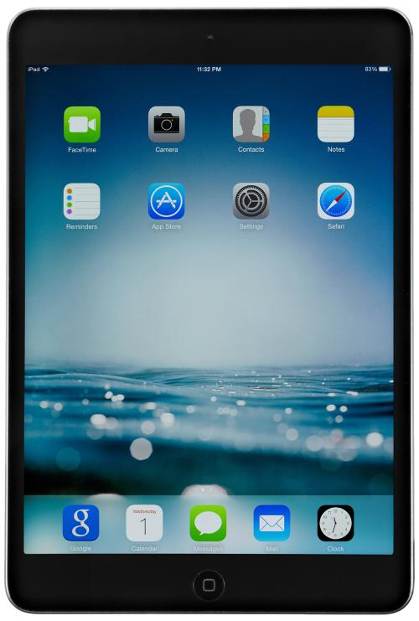
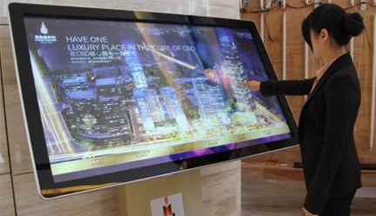
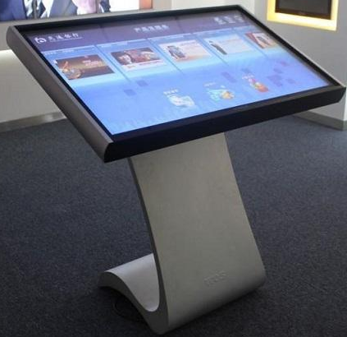
Direct-control pointing devices
Touchscreens are canonical direct control pointing devices
Touchscreens are often integrated into apps directed at novice user
High-precision designs dramatically improved touchscreens
Hardware provides up to 1600*1600 pixel resolution
The lift-off strategy enables users to point at a single pixel
Notes:
The lift-off strategy has three steps: Users touch the surface and then see a cursor that they can drag to adjust its position; when they are satisfied, they lift their finger off the display to active

Slide 21
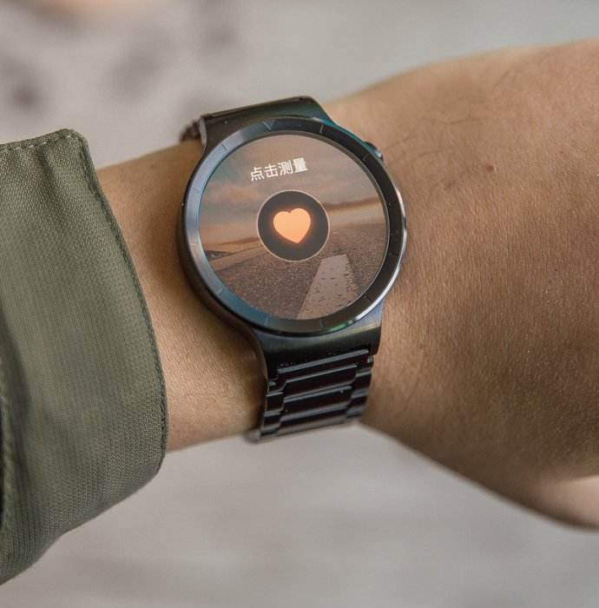
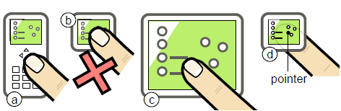
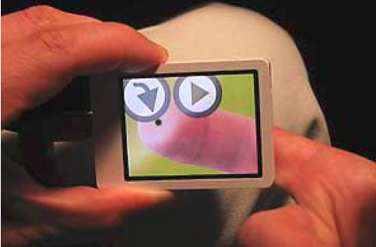
Direct-control pointing devices
High-precision touchscreens have transformed mobile devices
“Fat finger” problem
Solution
Using the back of the device
Shift

Slide 22
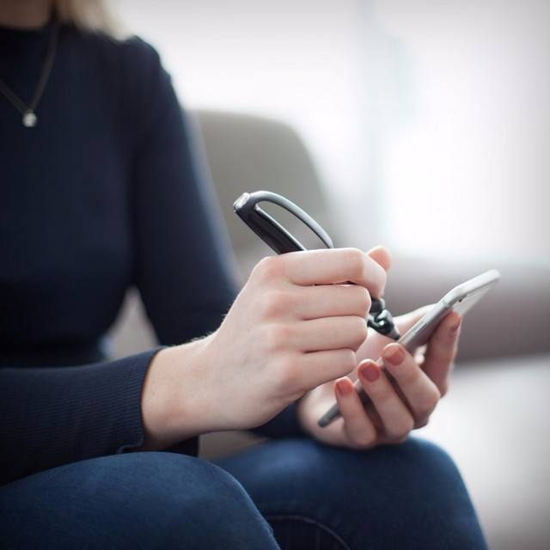
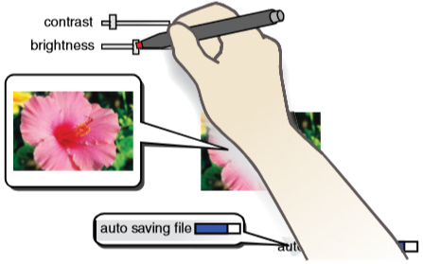
Direct-control pointing devices
High-precision touchscreens have transformed mobile devices
“Fat finger” problem
Solution
Occlusion-aware interfaces
Stylus

Slide 23
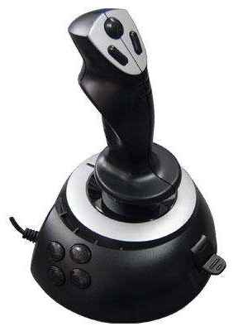

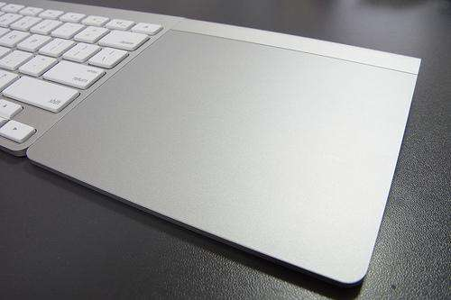
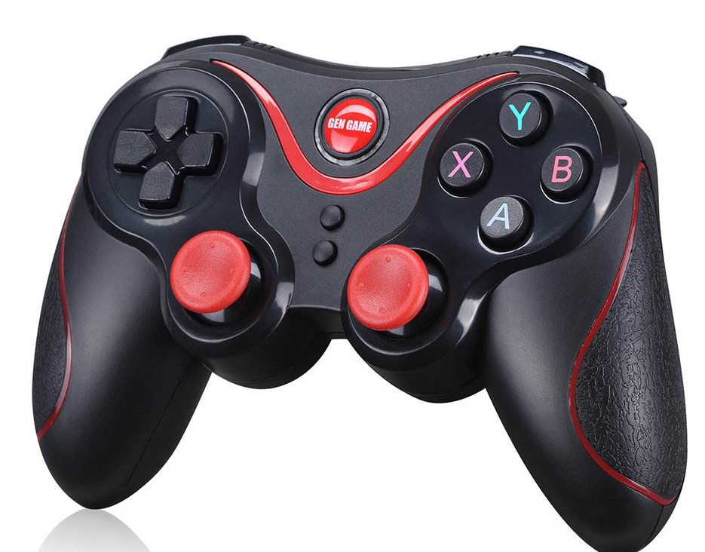
Indirect-control pointing devices
Indirect pointing devices separate the input (monitor) space from the output (display) space
Provide a surface for the hand to rest
However, they require the hand to locate the device and demand hand/eye coordination

Slide 24
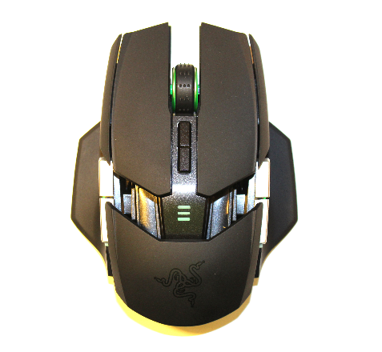
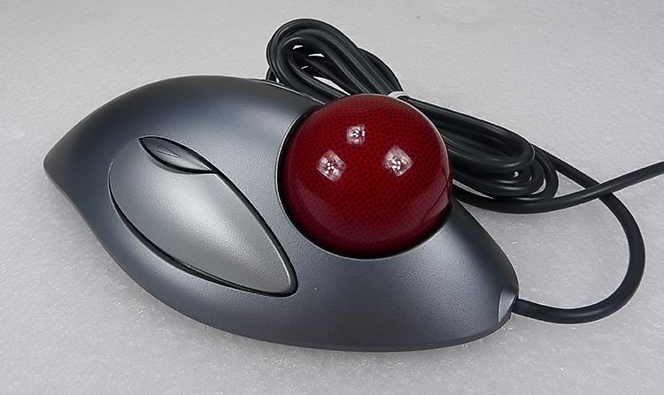
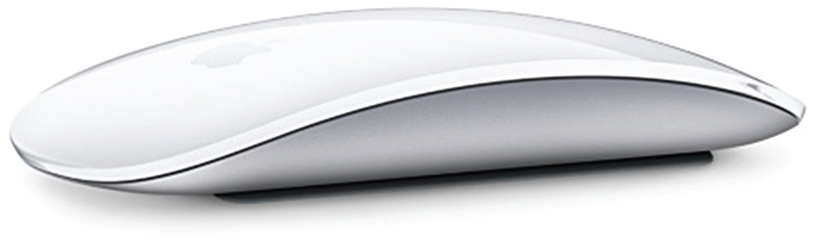
Indirect-control pointing devices
The mouse is the most common indirect pointing device
Problems:
Consume desk space
Separate attention between the motor and display space
The trackball is controlled by spinning a ball along two axes

Slide 25
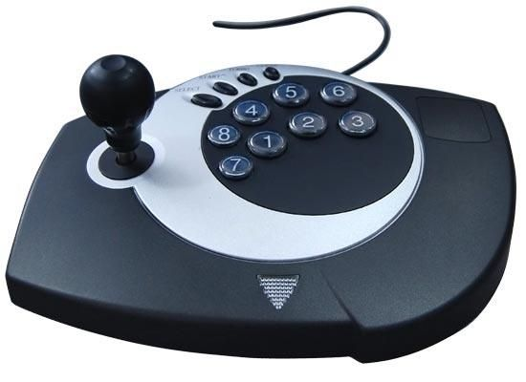
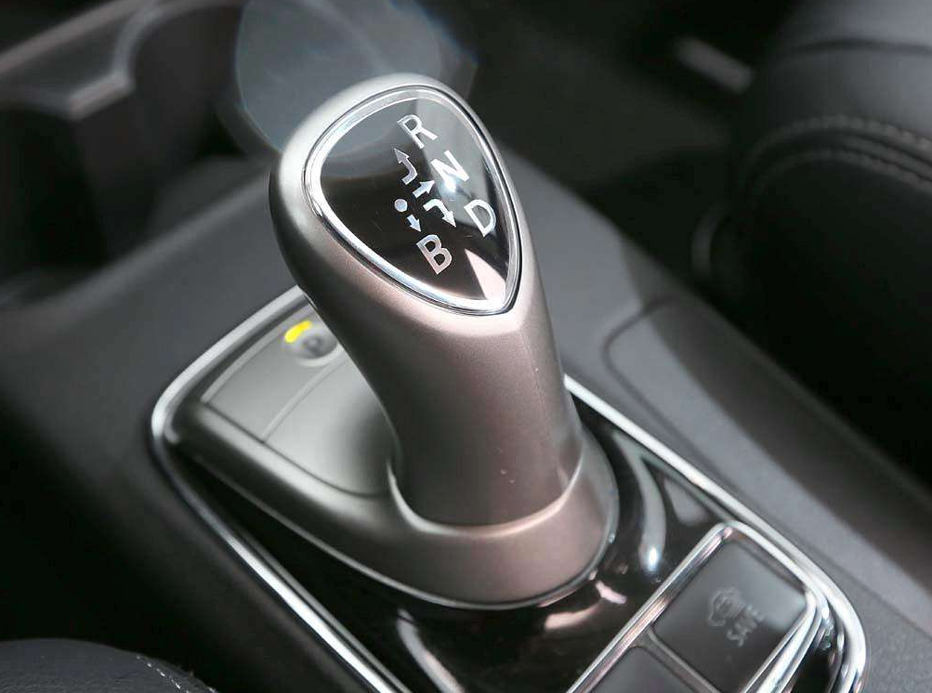
Indirect-control pointing devices
The joystick has dozens of versions with varying stick lengths and thicknesses, displacement forces and distances, anchoring strategies for bases, and placement relative to the keyboard and screen
Joysticks are appealing for tracking purposes

Slide 26
Indirect-control pointing devices
The direction pad originated in game consoles and consists of four directional arrows arranged in a cross with a trigger button in the center

Slide 27
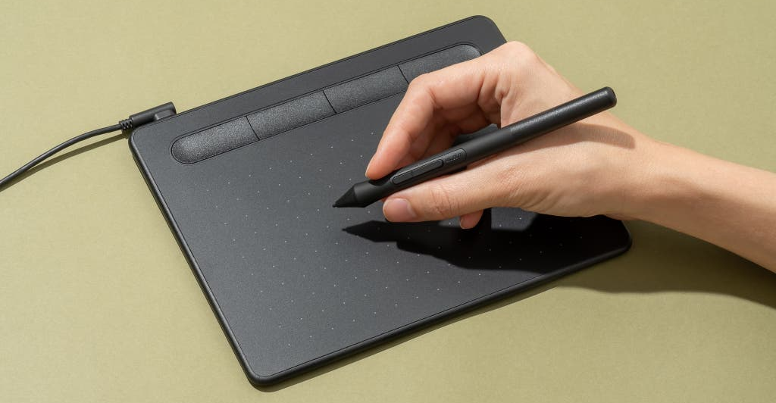
Indirect-control pointing devices
The graphics tablet is a touch-sensitive surface separate from the screen, usually laid flat on the desk/table or in the user’s lap

Slide 28
Comparison of pointing devices
Speed
Touchscreen <mouse < trackball/touchpad < pointing stick
For some tasks, pointing devices are faster than cursor keys, while for other tasks, they are not
Users with motor disabilities prefer joysticks and trackballs
Notes:
In summary, the touchscreen and trackball are durable in public-access, shop-floor, and laboratory applications. The mouse, trackball, trackpoint, graphics tablet, and touchpad are effective for pixel-level pointing. Pens and styli are appreciated for drawing and handwriting, and simple gestures can be used to specify actions and quantify their parameters. Cursor jump keys remain attractive when there are a small number of targets. Joysticks are appealing for games or specialized navigation applications.

Slide 29
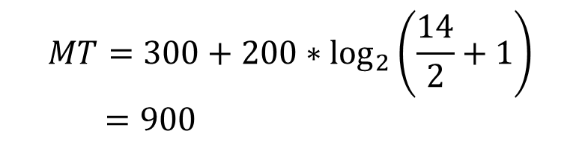
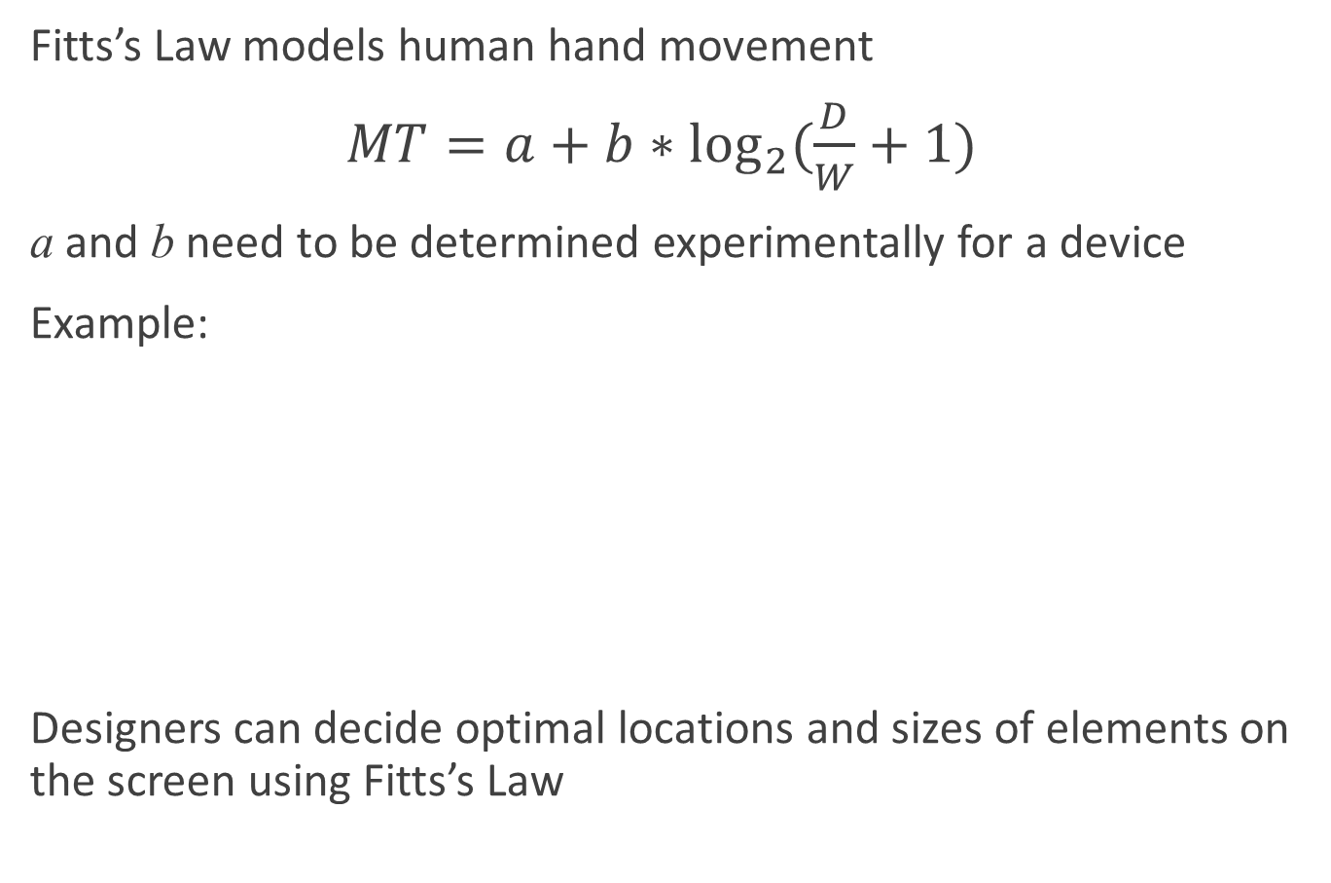
Fitts’s Law
Fitts’s Law models human hand movement
$MT=a+b∗\log_{2}{(\frac{D}{W}+1)}$
a and b need to be determined experimentally for a device
Example:
Designers can decide optimal locations and sizes of elements on the screen using Fitts’s Law
a = 300 milliseconds
b = 200 msec/bit
D = 14 cm
W = 2cm
$$MT=300+200∗\log_{2}\left(\frac{14}{2}+1\right)$$
$=900$

Slide 30
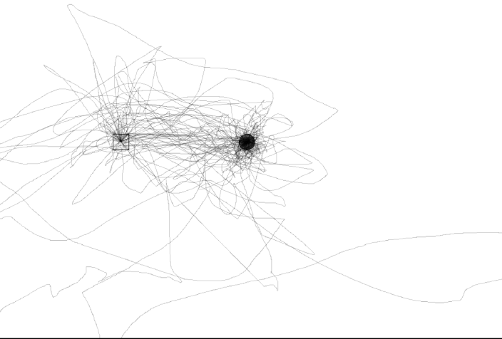



Fitts’s Law
There is also a fine-tuning motion of the fingers to move in small targets
$PPMT=a+b∗\log_{2}\left(D/W+1\right)+c∗\log_{2}{(D/W)}$
Fitts’s Law works well for the adults, but it need refinements for children or older adults.
Notes:
How to design devices that produce smaller a and b:
Multi-scale pointing with zooming
2. Crossing-based interfaces

Slide 31









Novel pointing devices
Notes:
eye-tracker
http://m.sohu.com/a/161749319_791821?_f=m-article_34_feeds_21
SpacePilot Pro 3D 鼠标 售价499美元，折合人民币3300元左右。
http://mouse.zol.com.cn/130/1302313.html
Ubiquitous computing and tangible UI: RFID
Livescribe
http://www.livescribe.com/en-us/
力反馈手套: http://news.expoon.com/c/20171122/19647.html

Slide 32
Outline
Introduction
Keyboards and keypads
Pointing devices
Displays

Slide 33
Characteristics of displays
Physical dimensions (usually the diagonal dimension and depth)
Resolution (the number of pixels available)
Number of available colors and color correctness
Luminance, contrast, and glare
Power consumption
Refresh rates (sufficient to allow animation and video)
Cost
Reliability
Notes:
Usage characteristics:
portability, privacy, saliency, ubiquity, simultaneity

Slide 34





Display technology
CRT -> LCD
Thin form, light weight, low electricity consumption
Plasma displays are suitable for mounted wall displays
LEDs are being used in large public displays
Electronic ink displays
Notes:
An Amazon Kindle (http://www.amazon.com/) book reader being used to browse Bleak House by Charles Dickens.
The Kindle uses E-Ink® technology (http://www.eink.com/), providing a bright display that uses power only when the display changes, and can be read in direct sunlight and at varying angles, which can improve reading comfort (see Section 14.4 for a discussion of reading on paper versus on a display).

Slide 35



Large wall displays
There are three types of large wall displays
Informational wall displays
Interactive wall displays
Multiple-desktop displays
Notes:
Users discussing and pointing at details on the Stony Brook University Reality Deck (Papadopoulos et al., 2014), an immersive giga-pixel display consisting of 416 thin-bezel LCD displays and powered by 18 graphics workstations connected using a high-speed network (https://labs.cs.sunysb.edu/labs/vislab/reality-deck-home/)
Two users collaboratively control a lens on a gigapixel image of Paris, France using a tablet touchscreen as well as an interactive cursor (Chapuis et al., 2014)

Slide 36

Tabletop displays
Horizontal displays invite collaboration and discussion
Such as creative design, problem solving
Tabletops are often equipped with multi-touchscreens
Using stereoscopic displays, volumetric displays, or head-mounted displays, it may become possible to design effective 3D tabletop interactions
Notes:
Two people collaborating on a real estate task using a tabletop display and mobile table
The tabletop serves as a shared and public display where changes affect all collaborators, whereas the tablet is perceived as a private display that allows users to work independently (McGrath et al., 2012)
DiamondTouch by Circle Twelve

Slide 37







Heads-up and head-mounted displays
A heads-up display projects information on the partially silvered windscreen of an airplane or car
The head-mounted display (HMD) are used in VR or AR apps

Slide 38


Mobile device displays
Mobile devices widespread in personal and business applications
They can improve medical care, facilitate learning, etc.
Smartwatches integrate step counters, heartbeat, GPS, text, email, calendar, voice recognition, and electronic payment
Notes:
The Apple Watch on the left supports both fitness as well as personal information management applications, such as email, calendar, and electronic payment
The Fitbit Surge smartwatch on the right is designed mainly for personal fitness applications, and contains a step counter, heart rate monitor, and GPS

Slide 39
Mobile device displays
Mobile devices can be grouped in four classes depending on their intended usage
General-purpose work (Pocket PC)
General-purpose entertainment (iPod)
General-purpose communication and control (phones)
Targeted devices that do only a few tasks
When design interfaces for mobile devices, data entry and complex tasks should be reduced

Slide 40

Responsive design
Interaction design for mobile devices requires adapting content to display
Responsive web design (RWD) is an approach to creating webpages and web apps
Basic principles of RWD
Mobile-first design
Unobtrusive dynamic behavior
Progressive enhancement
Notes:
The monitor layout on the left is automatically adapted to the smaller display space of a tablet (middle) and a smartphone (right)

Slide 41





Deformable and shape-changing display
Current displays are flat
Future displays will be shape-changing in that they bend, move, and respond to physical interactions
Notes:
The left image shows a physical bar chart visualization displaying complex data (Jansen et al., 2013)
The middle shows the tilt display that consists of multiple small displays mounted on actuators (Alexander et al., 2012)
On the right is the PaperPhone, a flexible smartphone prototype that supports bending interaction (Lahey et al., 2011)
Tilt display: http://v.youku.com/v_show/id_XNDU0MTI0MDY4.html
inform dynamic shape display: http://tangible.media.mit.edu/project/materiable/ https://www.vmovier.com/46631?from=tag__title

